Slide 1
Predictive Maintenance Workshop Originally Created: Sep. 2015 Last Updated: Oct. 2020
Tyler Chessman
tylerc@microsoft.com
Microsoft

Slide 2
AGENDA
Introductions - review of the day
Your Expectations
Your Prior (analytical) Experience
Introduce the Predictive Maintenance Template
Overview of Azure Machine Learning
Work through the template
Wrap-Up

Slide 3
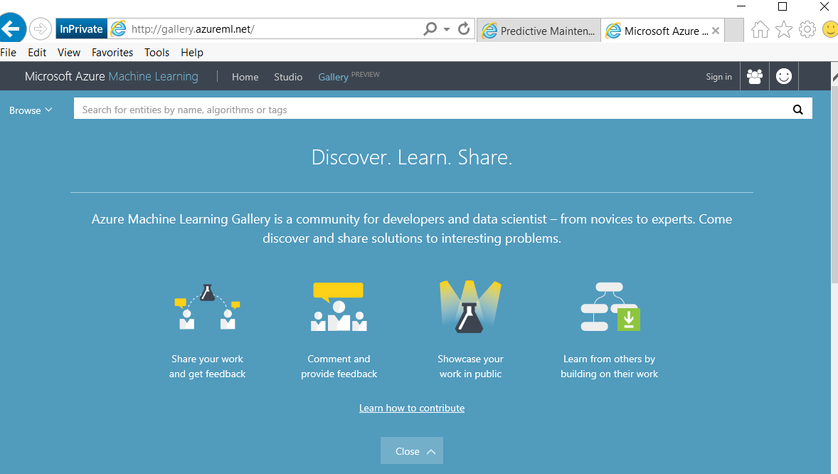
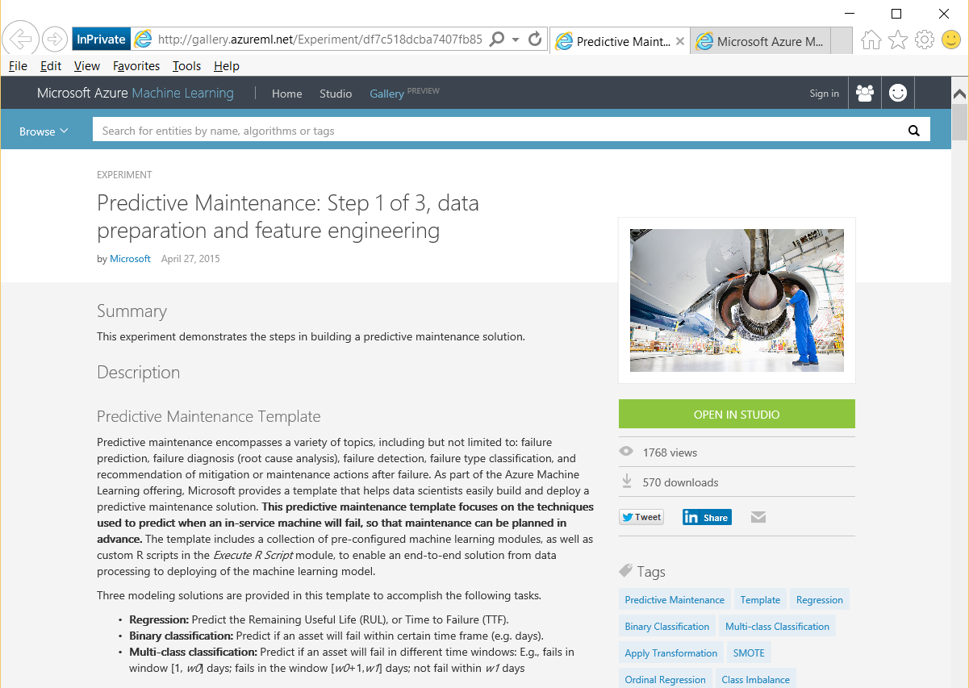
The Predictive Maintenance Template
Available in the Azure Gallery
Built by Microsoft Data Scientists
“…focuses on the techniques used to predict when an in-service machine will fail, so that maintenance can be planned in advance.
Includes a collection of pre-configured ml modules, and custom R scripts, to enable end-to-end solution from data processing to deployment

Slide 4
The Predictive Maintenance Template Continued…
Three modeling solutions are provided in the template:
Regression: Predict the Remaining Useful Life (RUL), or Time to Failure (TTF).
Binary classification: Predict if an asset will fail within certain time frame (e.g. days).
Multi-class classification: Predict if an asset will fail in different time windows: E.g., fails in window [1, w0] days; fails in the window [w0+1,w1] days; not fail within w1 days
The template uses a publicly available dataset* – aircraft engine run-to-failure events
Assumption – equipment has a progressing degradation pattern
Pattern can be observed by sensor measurements over time
Note – The entire “template” spread across 7 Gallery experiments
The documentation is repeated across each experiment
You can add each experiment to your workspace
*A. Saxena and K. Goebel (2008). "Turbofan Engine Degradation Simulation Data Set", NASA Ames Prognostics Data Repository (http://ti.arc.nasa.gov/tech/dash/pcoe/prognostic-data-repository/), NASA Ames Research Center, Moffett Field, CA

Slide 5
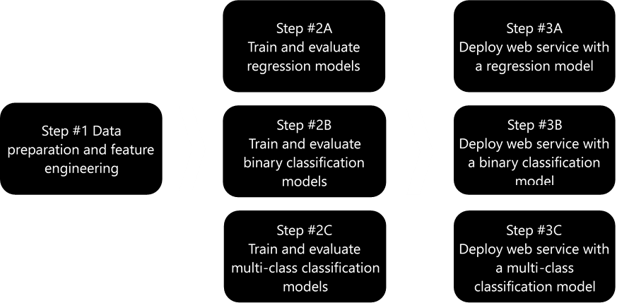
The Predictive Maintenance Template The seven experiments

Slide 6
AGENDA
Introductions - review of the day
Your Expectations
Your Prior (analytical) Experience
Introduce the Predictive Maintenance Template
Overview of Azure Machine Learning
Work through the template
Wrap-Up

Slide 7
Machine Learning & AI Portfolio When to use what?
Microsoft ML & AI products
Build your own or consume pre-trained models?
Build your own
Consume
Machine Learning / AI
Cognitive services*
*Some Cognitive Services (e.g., Vision) support code-free customization
Which experience do you want?
Code first
Visual tooling
(Cloud)
Deployment target
(On-prem) ML Server
Azure Machine Learning
Azure Synapse
Azure
DSVM
GitHub Codespaces
Power BI (ML)
Azure ML Visual Designer,
Azure ML Studio (classic)
What engine(s) do you want to use?
On-prem Hadoop**
SQL Server
Local,
ML compute instance or cluster,
AKS***
Azure Containers,
IoT Edge
Spark
** Can also be deployed to HDInsight
*** https://docs.microsoft.com/en-us/azure/machine-learning/concept-compute-target
Notes:
https://docs.microsoft.com/en-us/azure/machine-learning/concept-compute-target

Slide 8
Demo
Introducing Azure ML/ML Studio Classic

Slide 9
AGENDA
Introductions - review of the day
Your Expectations
Your Prior (analytical) Experience
Introduce the Predictive Maintenance Template
Overview of Azure Machine Learning
Work through the template
Wrap-Up

Slide 10
Machine Learning Flow
Deploy Solution
Define Objective
Collect & Prepare Data
Train Model
Analyze Results
Define Objective
Collect & Prepare Data
Normalizing features & feature selection
Splitting
Train Model
Algorithm selection
Parameter sweeping
Analyze Results
Scoring and evaluation
Iterating
Deploy

Slide 11
Machine Learning Flow Define Objective
Deploy Solution
Define Objective
Collect & Prepare Data
Train Model
Analyze Results
Proactively predict when equipment may fail
Remaining Useful Life (RUL) or Time to Failure (TTF)
Likelihood of failure within a certain time period (within w1 cycles)
Likelihood of failure within a set of windows (w0, w1, etc.)
Discussion – your particular use case(s)
Predictive Maintenance or other areas…
Segmentation (Clustering)
Classification/Prediction
Estimate/Forecast
Discussion – Other domains where these techniques may apply?

Slide 12
Machine Learning Flow Collect & Prepare Data
Deploy Solution
Define Objective
Collect & Prepare Data
Train Model
Analyze Results
The datasets for this template
Training data: engine run-to-failure data.
Testing data: engine operating data without failure events recorded.
Ground truth data: the true remaining cycles for each engine in the testing data.
More about the training data
train_FD001.txt, http://azuremlsamples.azureml.net/templatedata/PM_train.txt
Contains 20631 records, for 100 engines (denoted by id).
Each engine contains 21 sensor recordings (s1-s21) across a varying number of time periods (cycle).
The last cycle recorded is at the point of failure.
Three setting columns (setting1-3) are also included - though setting3 is a constant value across all rows.

Slide 13
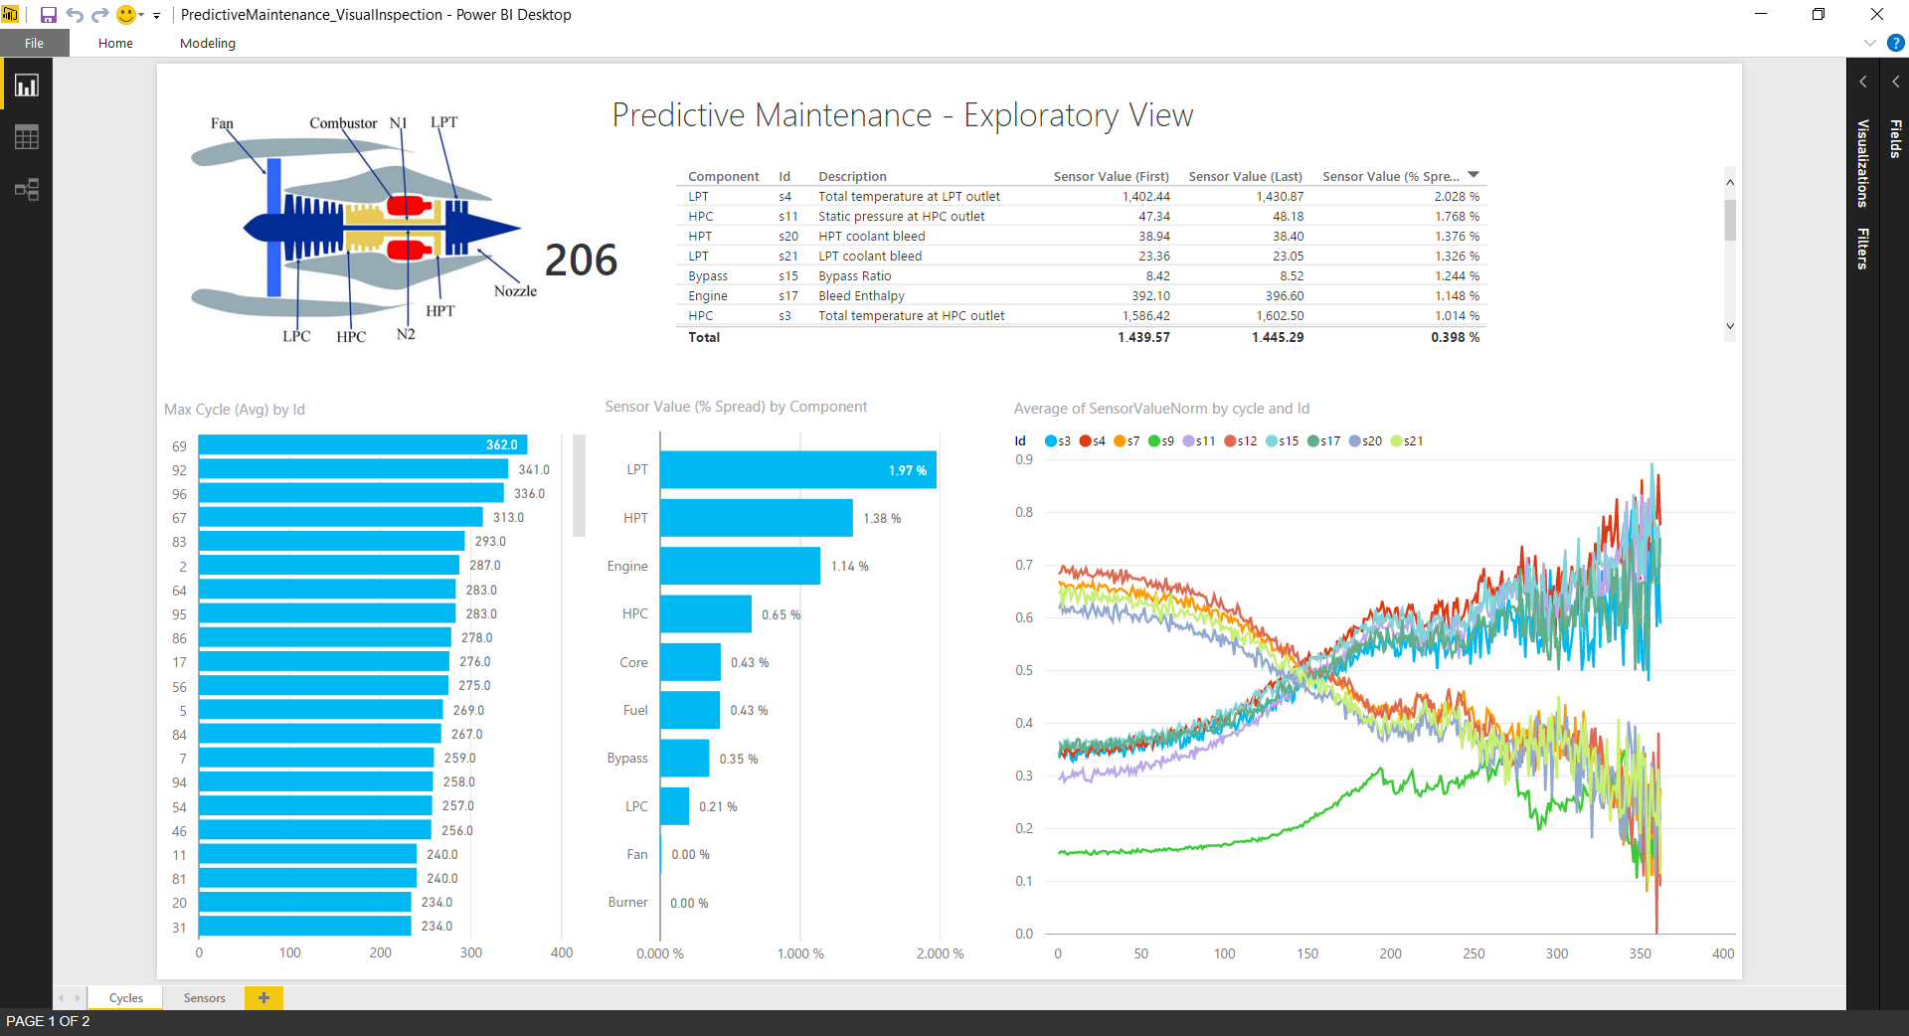
Hands On
Explore the Training Data

Slide 14
Machine Learning Flow Step 1: Data preparation and feature engineering
Deploy Solution
Define Objective
Collect & Prepare Data
Train Model
Analyze Results
The goal is to transform / augment input data sets
Training, Testing, and Truth
Uses a combination of built-in transforms and R scripts
Discussion – other ways to perform this logic? E.g.,
T-SQL / Stored Procs
SQL Server Integration Services
Power Query
Major transformations - Training Data
Add three columns (Data Labeling)
RUL - for regression models, contains a numeric count down of the row number in a set (the last row is denoted with a 0)
Label1 - for binary classification models ifelse(d2$RUL <= 30, 1, 0)
Label2 -for multi-class regression models ifelse(d2$RUL <= 15, 2, ifelse(d2$RUL <= 30,1,0)

Slide 15
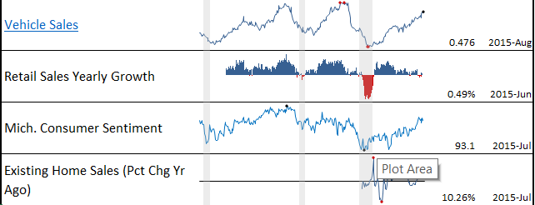
Machine Learning Flow Step 1: Data preparation and feature engineering
Deploy Solution
Define Objective
Collect & Prepare Data
Train Model
Analyze Results
Major transformations - Training Data (Continued)
“Feature Engineering”
Along with the “raw” features (original sensor readings, we add aggregate features
a1-a21 - moving average of the corresponding sensor measure within the predefined window size w (5)
sd1-sd21 - moving standard deviation of the corresponding sensor measure within the predefined window size w (5)
Note - we also remove the id column from the dataset
Next, we Normalize Data (a built-in Azure ML Transform) - all columns except RUL, label1, & label2
Specifically, we apply a MinMax transformation (“Rescales numeric data to constrain dataset values to a standard range” - The min-max normalizer linearly rescales every feature to the [0,1] interval.).
We remove columns with all NAs from the data set
Discussion – other aggregates?
Trend value?
Persistent rise/fall >= x periods?
Above/Below a certain value?
Note - what about non-numeric variables?

Slide 16
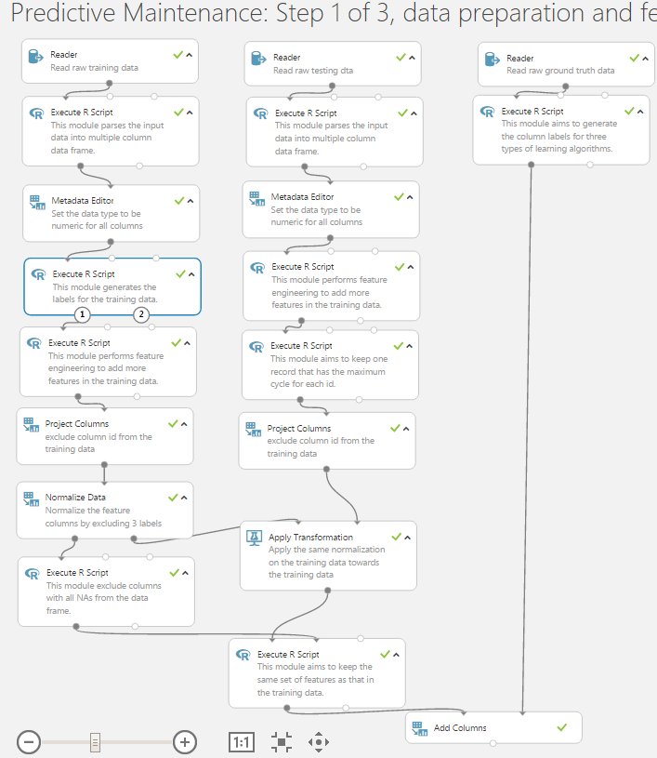
Hands On
Prepare the Training Data

Slide 17
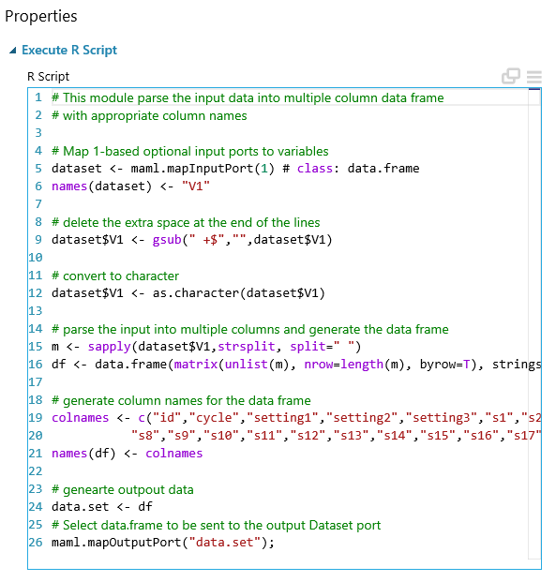
Machine Learning Flow Step 1: Data preparation and feature engineering
Deploy Solution
Define Objective
Collect & Prepare Data
Train Model
Analyze Results
What is R?
R is “a free software environment for statistical computing and graphics. It compiles and runs on a wide variety of UNIX platforms, Windows and MacOS”.
R Home page - https://www.r-project.org/
The Windows flavor of R comes with a console GUI; you may want to install an additional application like Rstudio for designing/debugging R scripts (www.rstudio.com)
Using R in Azure ML (Studio Classic)
The Execute R Script module R Script
Inputs – up to 2 datasets, and optional ZIP file that can include additional R code, R objects, R packages, and datasets
Outputs – Result dataset and console output/display of PNG

Slide 18
Demo
R and RStudio

Slide 19
Machine Learning Flow Step 1: Data preparation and feature engineering
Deploy Solution
Define Objective
Collect & Prepare Data
Train Model
Analyze Results
Testing data
The testing data ("test_FD001.txt") has the same schema as the training data.
Note – this data does not indicate when the failure occurs (in other words, the last time period does NOT represent the failure point). Taking the sample testing data shown in the following table as an example, the engine with id=1 runs from cycle 1 through cycle 31. It is not shown how many more cycles this engine can last before it fails.
In the Azure ML Experiement, this dataset is taken through some of the same transformations as the training data -
a1-a21 and sd1-sd21 columns are added.
Unlike the training data, only the last row for each id is kept (use this row for prediction)
The data has the same normalization applied
Finally, we remove columns that were removed from the training data (i.e. looking for columns with all NAs)
Truth data
The ground truth data (RUL_FD001.txt) provides the number of remaining working cycles for the engines in the testing data.
RUL, Label1, and Label2 columns are added based on the same rules as the training data
These fields are then added to the testing data

Slide 20
Machine Learning Flow Choosing the right model
Deploy Solution
Define Objective
Collect & Prepare Data
Train Model
Analyze Results
These templates focus on:
Regression - predicting a numeric (dependent) variable based on 1 or more independent variable
Binary classification – e.g., Yes/No, On/Off
Multi-class classification – e.g., Short, Medium, Tall
How do you know which algorithm to choose?
Reference – The Machine Learning Algorithm Cheat Sheet*
Different types of machine learning
Supervised – make predictions based on a set of examples
Unsupervised – data points have no labels associated with them; the goal is to organize the data
Reinforcement Learning - the algorithm gets to choose an action in response to each data point (currently not natively available in ML)
Considerations when choosing an algorithm
Accuracy
Training time
Linearity
Number of Parameter
Number of Features
*https://azure.microsoft.com/en-us/documentation/articles/machine-learning-algorithm-cheat-sheet/

Slide 21
Machine Learning Flow Step 2a: Train & Evaluate Regression Models
Deploy Solution
Define Objective
Collect & Prepare Data
Train Model
Analyze Results
Goal – predict time to failure i.e. remaining cycles
Train/Score 4 regression models
Decision Forest Regression
Decision Trees are non-parametric models that perform a sequence of simple tests for each instance, traversing a binary tree structure until a leaf node (decision) is reached. This regression model consists of an ensemble (blended result) of decision trees
Boosted Decision Tree Regression
Creates an ensemble of regression trees using boosting – each tree is dependent on prior trees, and learns by filtering the residual of the trees that preceded it (tends to improve accuracy with some small risk of less coverage)
Poisson Regression
Valid for predicting numeric values – typically counts
Poisson distribution is a discrete probability distribution (limited number of possible observations)
Neural Network Regression
From the SQL Server Data Mining book…. Neural networks works by creating and training artificial neural paths (relationships between inputs and outputs) that are used as patterns for further predictions.
Filter-based feature selection
Pearson correlation to narrow independent variables (features)
All 4 models are scored – results are presented in a table

Slide 22
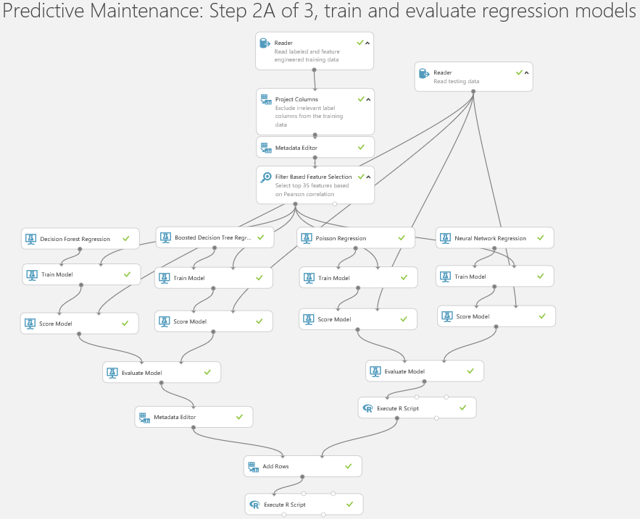
Hands On
Build a Regression Model
Step 2A

Slide 23
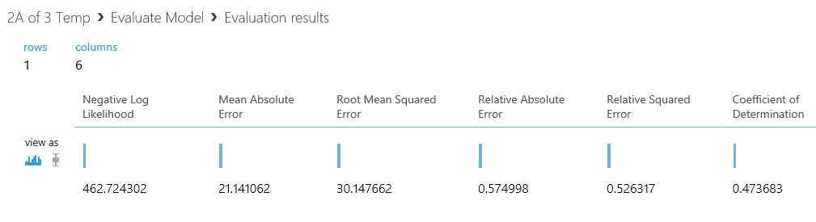
Machine Learning Flow Step 2a: Train & Evaluate Regression Models
Deploy Solution
Define Objective
Collect & Prepare Data
Train Model
Analyze Results
How should you evaluate a regression model?
Closest with going over (Price is Right)
Closest to actual (allow errors to cancel each other out)
Closest to actual (evaluate errors in terms of absolute value)
No prediction should fall outside of a certain threshold (e.g., 15% error)
Evaluate results in Azure ML*
*Log Likelihood not available for all model; Compare Regression models - http://gallery.azureml.net/Experiment/f35e1ba8a0a34ccd9ce2dc0758de34cb

Slide 24
Hands On
Regression Evaluation Metrics
Step 2B

Slide 25
Machine Learning Flow Using Parameter Sweeping to Improve Accuracy
Deploy Solution
Define Objective
Collect & Prepare Data
Train Model
Analyze Results
Used in lieu of the Train Model module
Lets you “…build and test models using different combinations of settings, in order to determine the optimum parameters for the given prediction task and data.”
Default trainer mode for models in AzureML is Single Parameter i.e. fixed values for all model parameters (maximum depth of decision trees, minimum number of observations in a leaf node, etc)
With parameter sweeping, you:
Create “grids” of values for all or some parameters
And then AzureML:
Builds and evaluates models with combinations of values from these grids
Chooses the best model from the candidate models

Slide 26
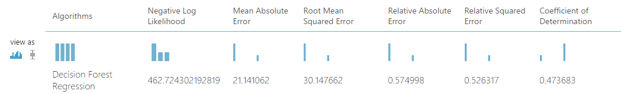
Machine Learning Flow Parameter Sweeping Example
Deploy Solution
Define Objective
Collect & Prepare Data
Train Model
Analyze Results
Default Model
462.7 21.1 30.1 57.5% 52.6% .4736
Parameter Sweeping
440.7 20.2 27.5 54.8% 43.7% .5627

Slide 27
Machine Learning Flow Step 2b Train and evaluate binary classification models
Deploy Solution
Define Objective
Collect & Prepare Data
Train Model
Analyze Results
Goal – Predict if an asset will fail within a certain time frame
In this case, within w1 cycles, where w1 has been set to 30
Train/Score 4 binary classification models
Two-Class Logistic Regression
Used to predict one of two states of a target variable
Logistic regression is a well-known method in statistics that is used to predict the probability of an outcome
Two-Class Boosted Decision Tree
Two-Class Decision Forest
Two-Class Neural Network
This experiment also shows how to “balance the class distribution by down sampling the records with the majority class”.
In other words, we sample the dataset to extract out all of the minority cases (in this case, within 31 periods of a failure) and then keep as subset of majority cases (non-failure rows). The result - we go from 20631 training records (with 3100 pending failure rows and 17531 non-failure rows) to a training set of 6200 records (half of each).
This technique may also be referred to as oversampling - http://sqlmag.com/business-intelligence/sql-server-2005-data-mining-add-ins-office-2007.

Slide 28
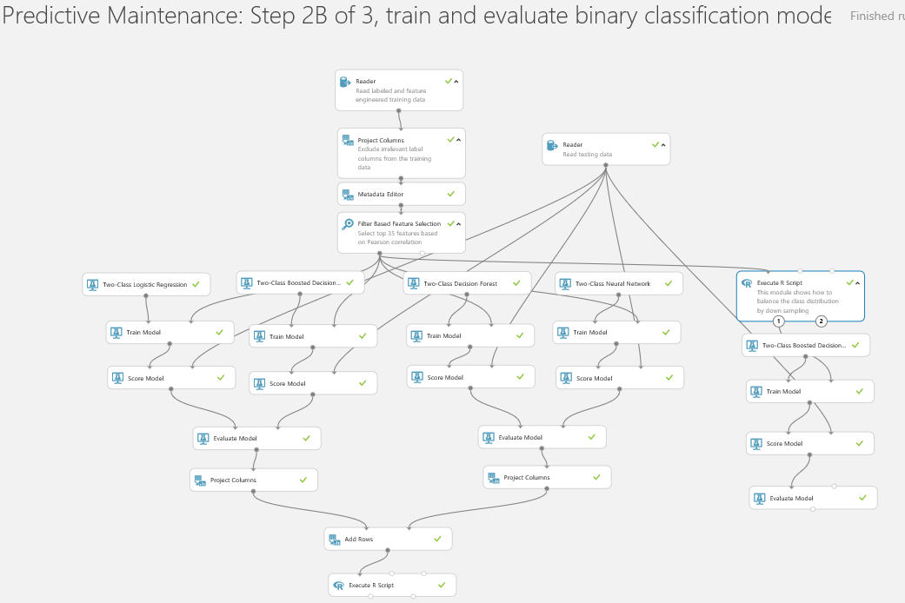
Hands On
Binary Classification Model
Step 2C

Slide 29
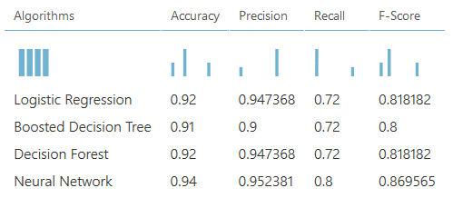
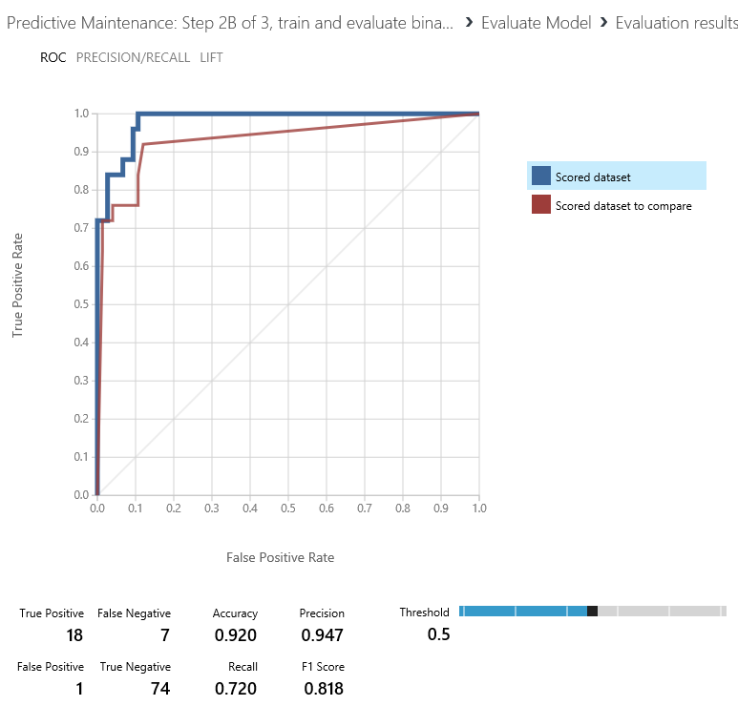
Machine Learning Flow Step 2b Train and evaluate binary classification models
Deploy Solution
Define Objective
Collect & Prepare Data
Train Model
Analyze Results
How should you evaluate a classification model?
Right or wrong
But, may want to consider probability score as well
Evaluate results in Azure ML
Boosted Decision Tree (down sampling) | 0.9 | 0.778 | 0.84 | 0.808
*.

Slide 30
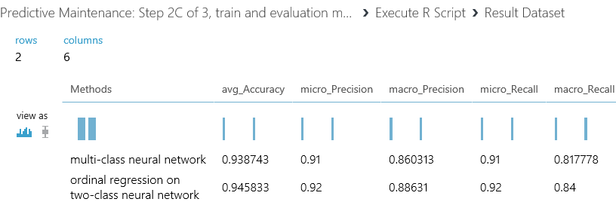
Machine Learning Flow Step 3C - train and evaluation multi-class classification models
Deploy Solution
Define Objective
Collect & Prepare Data
Train Model
Analyze Results
Goal – Predict if an asset will fail within a given window
E.g., fail within in window [1, w0], [w0+1, w1]
Train/Score 4 models
Two multiclass classification models
Multiclass Logistic Regression
Multiclass Neural Network
Two ordinal regression models (an ordinal variable is a variable whose value can be ranked or ordered – but distance between these values is unknown)
Two-Class Logistic Regression
Two-Class Neural Network
The results indicate ordinal regression on two-class neural network is the most accurate

Slide 31
Machine Learning Flow Step 3A – Deploy Regression Web Service
Deploy Solution
Define Objective
Collect & Prepare Data
Train Model
Analyze Results
Once an experiment has been validated, you can use it an production environment
Azure ML lets you publish an experiment as a Web Service with inputs/outputs
Typical steps to convert an experiment into a web service:
Convert the model(s) that were trained during the experiment into persisted Training Models (this can be done via right-clicking on the output node of a “Train Model” step (need to first run the experiment) and selecting the “Save as Trained Model” menu-item
Specify a Web service input defining the required input data set – and where in the experiment this dataset will be passed
Specify a Web service output – which is often times appended to the final step in an experiment (e.g., a Score Model step)
Notes
In addition to a web service output, you could also write output via the Writer module
Azure ML can automate much of the web service publishing process

Slide 32
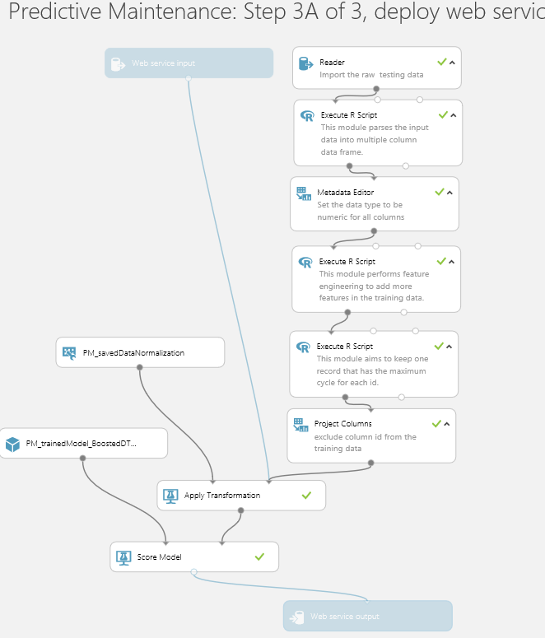
Hands On
Deploy an Azure ML Web Service
Step 3A

Slide 33
Machine Learning Flow Step 3A – Deploy Regression Web Service
Deploy Solution
Define Objective
Collect & Prepare Data
Train Model
Analyze Results
How to test/call an Azure ML Web Service
Sample Excel workbook (problems with implementation)
Azure Machine Learning Excel Add-in (codeplex - http://azuremlexcel.codeplex.com/)
Office “Modern App” for Azure ML
Custom development (.NET, Python, and R sample code provided in the Web Svc documentation)
Production Use Cases
Row-level Request/Response from a custom application
Batch Execution calls

Slide 34
Demo
Calling an Azure ML Web Service

Slide 35




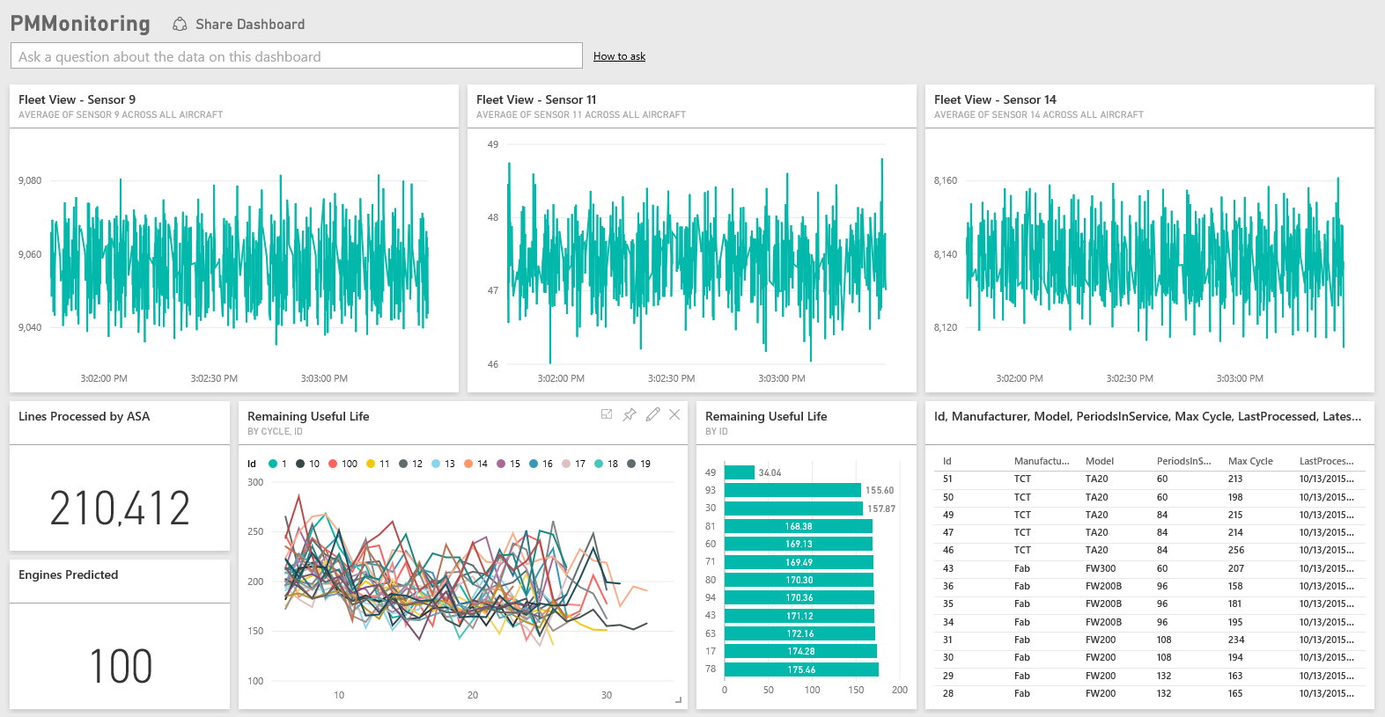
Reference Architecture Monitoring Remaining Useful Life (RUL)
Azure
Storage
Notes
Summary data scored by Azure ML
Scored results sent back to Azure SQL
Aggregate
Into DB (Tumbling Window)
Azure
SQL Database
Azure
Data Factory
Azure
Machine Learning
AMQP
Https
Push to
Power BI
RUL Results (every 15 minutes)
Event Ingress –
Azure Event Hubs
Event Consumer -
Azure Stream Analytics
Event Publishers e.g.,
Devices, Services
Power BI

Slide 36
AGENDA
Introductions - review of the day
Your Expectations
Your Prior (data mining / machine learning) Experience
Introduce the Predictive Maintenance Template
Overview of Azure Machine Learning
Work through the template
Wrap-Up

